Slide 1
Reported Speech
“when we tell someone what another person said”

Slide 2
Definition
Reported speech is the change of a direct speech sentence into an indirect speech sentence. Reported speech itself is usually used to restate what someone else has said. The direct speech that is changed into reported speech can be in the form of statement, imperative, yes-or-no question, and question about information.
Basically, to change a direct speech into reported speech can be done by changing pronouns, removing capital letters, removing quotes, modifying verbs, changing time reference (time mentioned in the conversation and or adding if).

Slide 3
There are four types of reported speech, namely :
1
2
Statement
Imperative
3
4
Yes – No Question
Information Question

Slide 4
Statement
We usually introduce reported statements with "reporting verbs" such as "say" or "tell":
He said (that)...
He told me (that)...
When we use our own words to report speech, there are one or two things that we sometimes change:
Pronouns may need to change to reflect a different perspective
Tense sometimes has to go back one tense (e.g present becomes past) – this is called backshift

Slide 5
Reported Statement :
Direct Statement
Reported Statement
“I am sick.”
He said that he was sick
“I work in London.”
Mary said she works in London
“It is hot in here”
She said it was hot in there

Slide 6
Imperative
Imperatives in reported speech are a little different than sentences. Imperatives can be used when we give orders and we can also use them to make requests.
So, we use “ask/tell + to + verb” to report command or imperative
“Be quiet.”
The teacher told the student to be quiet
“Bring it, please.”
He asked her to bring it.

Slide 7
Negative Imperative
For negative imperatives, we use “not to + verb”. However, you will often hear native speaker say “to + not + verb”.

Slide 8

A picture is worth a thousand words

Slide 9
Schedule
January
February
March
April
May
June
Phase 1
Task 1
Task 2
Phase 2
Task 1
Task 2

Slide 10
Methodology
Research
Analysis
Despite being red, Mars is a cold place
Venus has a beautiful name, but it’s hot
Data Study
Comparison
Jupiter is a gas giant and also the biggest
It’s composed of hydrogen and helium

Slide 11

A picture always reinforces the concept
Images reveal large amounts of data, so remember: use an image instead of long texts

Slide 12
Table
 | Test 1 | Test 2 | Test 3 | Test 4
Describe here your metrics 1
Describe here your metrics 2
Describe here your metrics 3
Describe here your metrics 4
Describe here your metrics 5

Slide 13
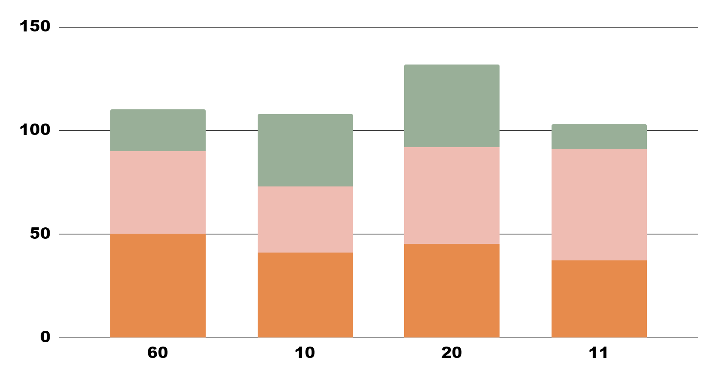
Results Analysis
Venus
Venus has a beautiful name
Saturn
Yes, it’s the ringed one
Mars
To modify this graph, click on it, follow the link, change the data and paste the new graph here
Mars is actually a cold place

Slide 14
Results Analysis
90%
30%
Mercury
Jupiter
40%
20%
Saturn
Earth
Mercury is the smallest planet
Jupiter is the biggest planet
Saturn is a gas giant
Earth is the planet we live on

Slide 15
You Can Use a Map
Venus
Venus has a beautiful name
Saturn
Yes, it’s the ringed one

Slide 16
This Is a Timeline
1
2
2
3
2
4
Mercury
Venus
Mars
Venus
It’s the closest planet to the Sun
Venus has a beautiful name
Mars is actually a cold place
It’s a gas giant and the biggest

Slide 17
Reviewing Concepts Is a Good Idea
Mars
Saturn
Jupiter
Despite being red, Mars is actually a cold place
Saturn is composed of hydrogen and helium
Jupiter is a gas giant and the biggest planet
Mercury
Venus
Neptune
Mercury is the closest planet to the Sun
Venus is the second planet from the Sun
It’s the farthest planet from the Sun

Slide 18
Awesome Words

Slide 19
Bibliographical References
AUTHOR (1992).
Title of the publication. Publisher
AUTHOR (2005).
Title of the publication. Publisher
AUTHOR (2008).
Title of the publication. Publisher
AUTHOR (2010).
Title of the publication. Publisher

Slide 20

Desktop Software
You can replace the image on the screen with your own work. Right-click on it and choose "Replace image" so you can add yours

Slide 21
Thanks!
Do you have any questions?
youremail@freepik.com
+91 620 421 838
yourcompany.com
Please keep this slide for attribution

